Slide 1
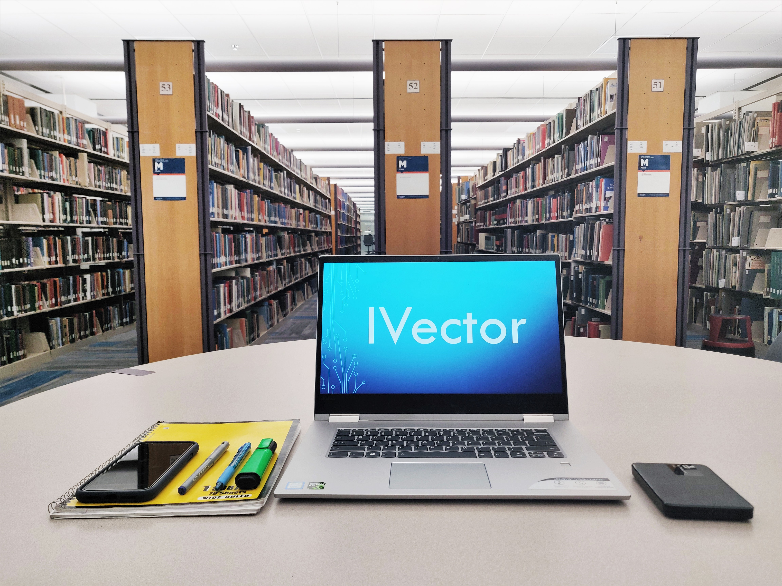
Team Innvotec Presents You Maintenance Plan for IVector
Product Owner: Pavan Kumar K S
Scrum Master: Priyanka Sharma
Team:
Manjushree,
Parijat Das
Priyanka Sri Ramasetty,
Rani Bishnoi,
Jai Santosh Mandava,
Yashaswani Bommanayakanahalli Mahalinga P
Under Guidance of Prof. Son Nguyen

Slide 2
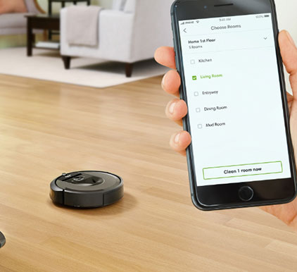
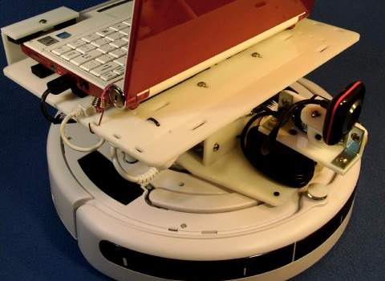
IVector AND SMART IOT CONNECTIONS
i-Vector is basically a machine mediator which is designed to connect and communicate with other devices in addition to smart cleaning of the rooms.

Slide 3
Software Maintenance
What is Maintenance?
Why Maintenance?

Slide 4
Purpose of Software Maintenance
Bug Fixing:
Capability Enhancement for changing environment:
Removal of Outdated Functions:
Performance Improvement:

Slide 5
Resources Allocation- Hardware
Laptops and Pc’s are allotted to every developer, tester, and team leader. The following are the configurations of them.
Processor: Intel I7 processor with 3.4GHz clock speed.
RAM: 16GB
Storage: 500GB SSD
Graphic card: AMD Radeon RX series
Display: HD to 4k screen

Slide 6

Resources Allocation- Software
Operating System: Windows 10 and Macintosh
Others: Microsoft Office 2016, Visual studios, XCode, Android Studio, MatLAB

Slide 7
Responsibilities
Train users or customers.
Documentations – TDD, FDD (Technical Design Documentation, Functional Design Documentation).
Proper communication amongst team members.
Debug existing source code and implement improved features.
24X7 support for the I-Vector software and the hardware based on the priority of the issues.
Design a proper flow/plan for Software Maintenance.
Communicate with the vendors and 3rd parties to deliver products on time.

Slide 8
Tools
Google forms
Google excel:
Incident tracking system
Knowledge Base

Slide 9
Techniques and Methods
Re-engineering
Reverse engineering
Structured programming
Third party inspection:

Slide 10
General Requirements - Product
Product Architecture and Components
User interface
Components
Core Functionalities
Hardware Level/Databases
Product Interfaces

Slide 11
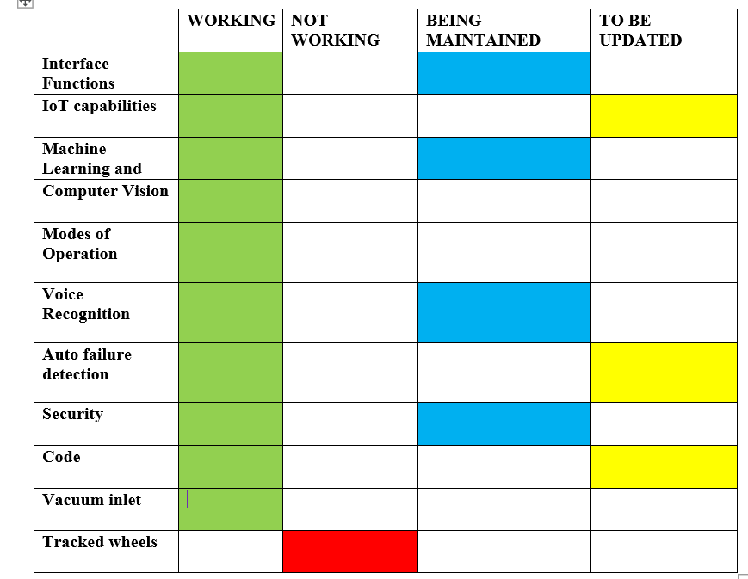
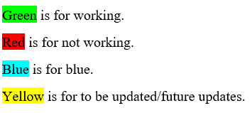
Status

Slide 12
Support
Why Support is Needed?
Customer Satisfaction
Product Quality
Training of end user
Providing business information for decision making
Market Reputation

Slide 13

Staff and Responsibility
Tech Support
Approver - 1
Senior Developer -2
Developer -2
Tester - 1
Team Leader - 1
Product Owner - 1

Slide 14
Contracts
Confirmation protocol
Parts request protocol
Cancelling protocol
New delivery date protocol

Slide 15
Support Period
SOFTWARE SUPPORT CHART
Software | Software Type | Date for 1st LTS release | STS period | LTS period
Flask | Application Framework | 25th March 2019 | 10 months | 2 years
Windows 10 | Operating System | 25th March 2019 | 10 months | 2 years
Linux | Kernel | 25th March 2019 | 10 months | 3 years
IVector UI | User Interface | 25th March 2019 | 10 months | 2 years
Oracle DB | Database | 25th March 2019 | 10 months | 3 years
LTS – Long Term Support
STS – Short Term Support
HARDWARE SUPPORT CHART
Hardware | Hardware Type | Date for 1st LTS release | STS period | LTS period
Filters and Bins | Filters and Bins | 25th March 2019 | 6 months | 1 years
Wheels and Brushes | Cleaner | 25th March 2019 | 10 months | 1 years
Sensors | Sensors | 25th March 2019 | 10 months | 3 years
Battery | Battery | 25th March 2019 | 6 months | 5 years

Slide 16

Problem Modification, Identification/Classification and Prioritization:
New Development
Bug/Issue with the working of Ivector
Incident Priority
- Very High, High, Medium, Low

Slide 17
Perfective Maintenance
Focus on after delivery updates which make the system reliable and competitive in the market for a long term
functional additions
functional enhancements
Increase system performance

Slide 18
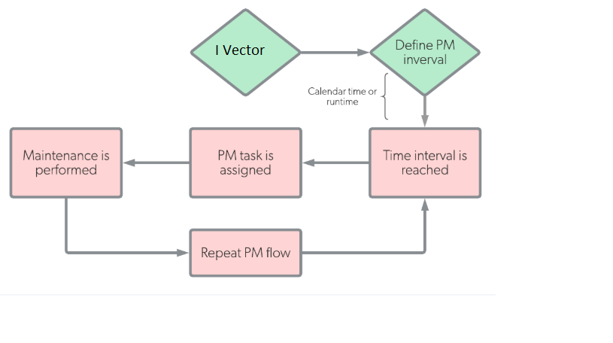
Preventive Maintenance
Time based preventive maintenance
Usage based preventive maintenance.
Predictive maintenance.
Prescriptive maintenance.

Slide 19
Preventive maintenance of I-Vector Examples
Hardware Preventive maintenance
Performance of the I-Vector components [Priority Very High]
Wheels and Brushes. [Priority Very High]
Sensors. [Priority Very High]
Software Preventive maintenance
Load Balancing [High]
Security Checks[High]

Slide 20
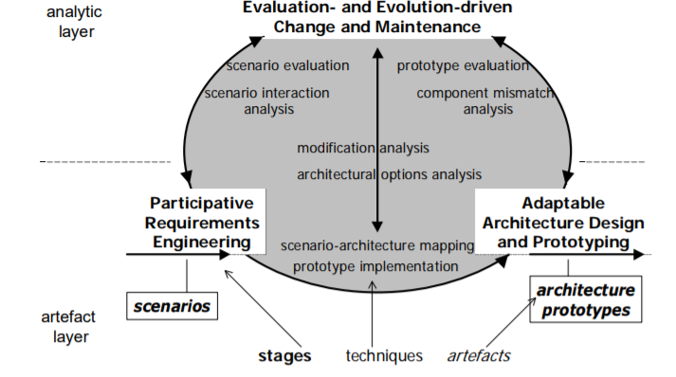
Adaptive maintenance
Adaptive maintenance is changing and adjusting the software according to the need and requirements of the environment.
User requirements.
Changes in government policies.
Competition in market- maintain customer base.
Software and hardware advancements.
New functionalities adjustment to the system.

Slide 21
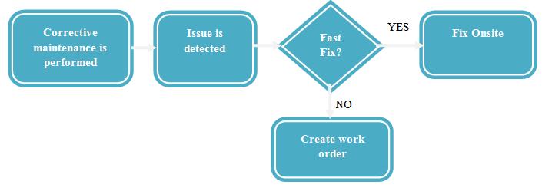
Corrective Maintenance
Corrective maintenance refers to modification or a maintenance task which will be initiated by the defects in the software of a product applications
Identify , analyze, separate and then rectify the defects
Subdivided into 2 types:
Immediate corrective maintenance
Deferred corrective maintenance
Workflow

Slide 22
Priority Based Testing Time
Very High | High | Medium | Low
2 Hours | 1 Day | 4 Days | 6 Days
1 Day | 3 Days | 10 Days | 15 days
Initial Response Time
Maximum Response Time

Slide 23
Design and Implementation

Slide 24
Design and Implementation
Pre-Implementation process
Process implementation
Problem and modification analysis
Modification implementation
Maintenance review and acceptance

Slide 25
Testing
Major Testing Approaches that have been used in implementation of the I-Vector
White
White Box Testing
Integration Testing
Black
Black Box Testing
System Acceptance Testing
Grey
Grey Box Testing

Slide 26
Types of Testing can be divided into 3 major parts
Functional Testing
Unit Testing
Integration Testing
Smoke Testing
User Acceptance Testing
Interoperability Testing
Maintenance Testing
Regression Testing
Maintenance Testing
Non Functional Testing
Performance Testing
Endurance Testing
Load Testing
Volume Testing
Scalability Testing
Usability Testing

Slide 27
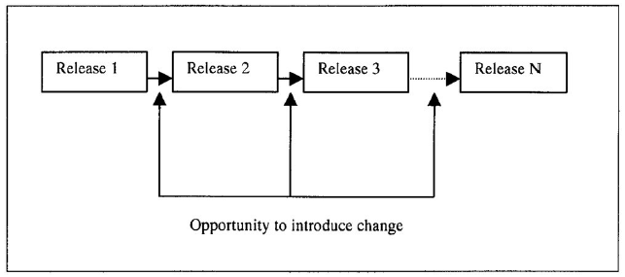
Delivery
Release
Installation and activation
Enable updates and built-in updates
Version tracking
Adaptation (which eventually falls under adaptive maintenance plan)

Slide 28
Anomaly Resolution & Reporting
Determine the criticality
Informal Check
Treat it as an incident
Use Knowledge Base for reporting

Slide 29
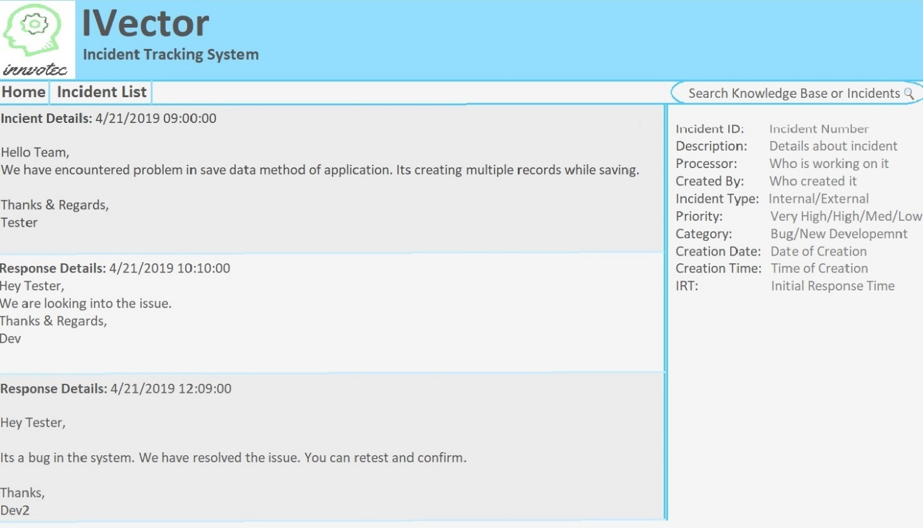
Tracking Maintenance Requests:
Google Docs
Incident Tracking System

Slide 30

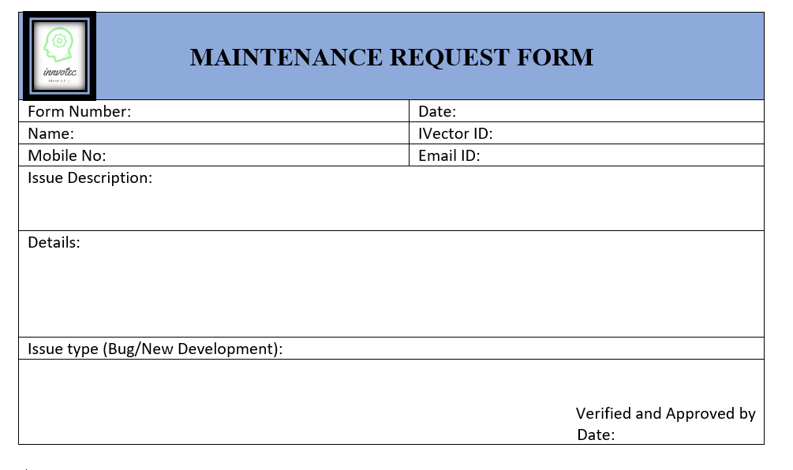

Slide 31
Google Form
Google Excel

Slide 32

References
Corrective Maintenance. (2002). Engineering Maintenance. doi:10.1201/9781420031843.ch5
Pasqualis, L. (2019, January 14). Software Maintenance, Understanding the 4 Types. Retrieved from https://www.coderhood.com/software-maintenance-understanding-the-4-types
Proceedings International Conference on Software Maintenance. (1997). 1997 Proceedings International Conference on Software Maintenance. doi:10.1109/icsm.1997.624223
System Maintenance and Support. (2002). Six Sigma Software Development. doi:10.1201/9781420031485.ch19
Yurtoğlu, N. (2018). Http://www.historystudies.net/dergi//birinci-dunya-savasinda-bir-asayis-sorunu-sebinkarahisar-ermeni-isyani20181092a4a8f.pdf. History Studies International Journal of History, 10(7), 241-264. doi:10.9737/hist.2018.658

Slide 33
Thank You

